Slide 1


Chronic Respiratory Disease:
Risk Modeling
Potential and Limitations
Alexander He
hea2@rpi.edu
Thilanka Munasinghe
munast@rpi.edu

Slide 2
Motivation
Chronic Respiratory Diseases (CRDs) are among the leading causes of mortality worldwide, with 545 million prevalent cases in 2017
Symptoms of non-infectious CRDs are often exacerbated by:
ambient air pollution
changes in temperature and humidity
Inspired by study where Machine Learning (ML) was successfully used to forecast the risk of Cholera outbreaks in India
Cholera Risk: A Machine Learning Approach Applied to Essential Climate Variables

Slide 3
Datasets
Mortality (cause-specific counts of death)
Population
Shapefiles (counties and climate divisions)
Spatiotemporal datasets
Fine particulate matter (PM2.5)
Carbon emissions, biosphere fluxes, burned area
Climate variables, drought indices

Slide 4
Scope
Period of interest: 2000 - 2016
Monthly temporal resolution
Counties in contiguous U.S.

Slide 5
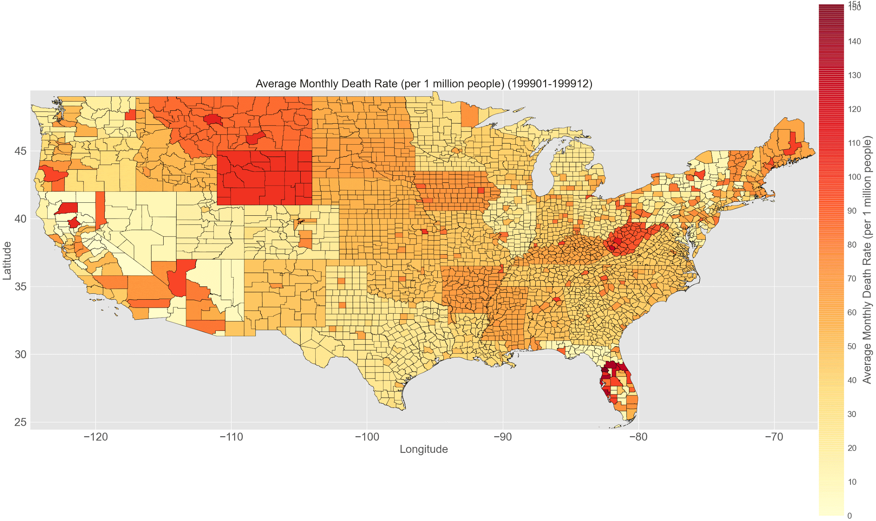
Mortality - Chronic Lower Respiratory Diseases (CLRDs)
CDC WONDER
Underlying Cause of Death
Includes:
asthma, emphysema, bronchiectasis, other COPDs (generally non-infectious)
Excludes:
influenza, pneumonia, other respiratory infections (infectious)

Slide 6
Population
Datasets - US Census Bureau
Monthly population totals for each county
Purpose: calculating mortality rate and population density

Slide 7
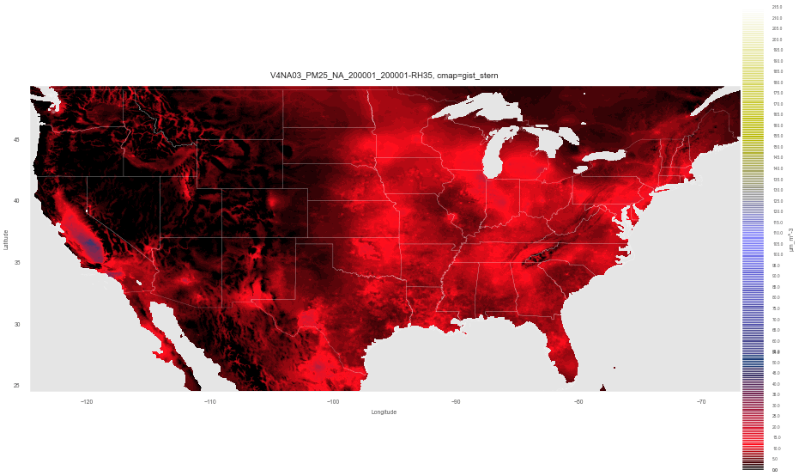
Fine particulate matter (PM2.5)
Atmospheric Composition Analysis Group
Washington University in St. Louis
0.01° × 0.01° grid
µg m⁻³
Notes:
.

Slide 8
Carbon Emissions, Biosphere Fluxes, Burned Area
Global Fire Emissions Database (GFED)
0.25° × 0.25° grid
Carbon emissions g C m⁻²
Biosphere Fluxes g C m⁻²
net primary production (NPP)
C gained (photosynthesis) minus C released (plant respiration)
heterotrophic respiration (R_{h})
fire emissions (BB)
Burned area
Fraction of each grid cell that burned in each month
Actual area - calculated with grid cell area data provided

Slide 9
Climate Variables, Drought Indices
NOAA Monthly U.S. Climate Divisional Database (NClimDiv)
By climate divisions
Climate variables
Temperature
Precipitation
Drought indices; negative = dry spells, positive = wet spells
Palmer Drought Severity Index (PDSI); -6 to +6
balance between moisture supply and demand.
Standardized Precipitation Index (SPI, SP01 for monthly); -3 to +3
0 = median of precipitation for particular location

Slide 10
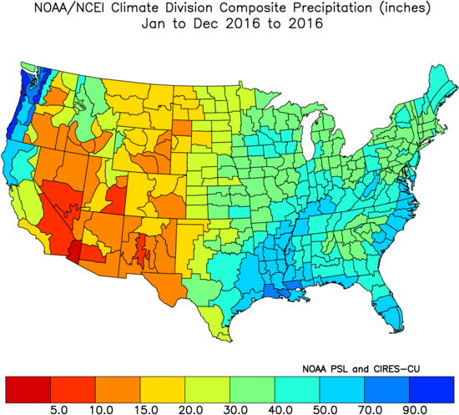
Total Precipitation, 2016
NOAA/NCEI U.S. Climate Division Data Plots: NOAA Physical Sciences Laboratory

Slide 11
Shapefiles - Counties, Climate Divisions
Boundaries - collections of points; polygons
Counties - Cartographic Boundary Files - US Census Bureau
Metadata
Location codes for county and state
Land + water area of each county
Purpose:
Determining the grid cells in each county (or climate division)
Calculating county population density

Slide 12
Data Preparation
Convert to identical 0.01° × 0.01° grid beforehand
Aggregate all spatiotemporal datasets by county and month
Adjust by total area of grid cells in each county
Include 1- and 2-month lags for spatiotemporal variables
Fine particulate matter (PM2.5)
Carbon emissions, biosphere fluxes, burned area
Climate variables, drought indices
Update county boundaries and designations
Changes to Counties and County Equivalent Entities: 1970-Present - US Census Bureau

Slide 13
Methods
70:30 train-test split
Random forest regression (scikit-learn)
10-fold cross validation
Hyperparameter tuning to optimize model
Feature selection - recursive feature elimination
Optimize R-squared
Collinearity analysis with Spearman rank correlation (SciPy)
Improves discussion of variables’ potential contributions to the model

Slide 14
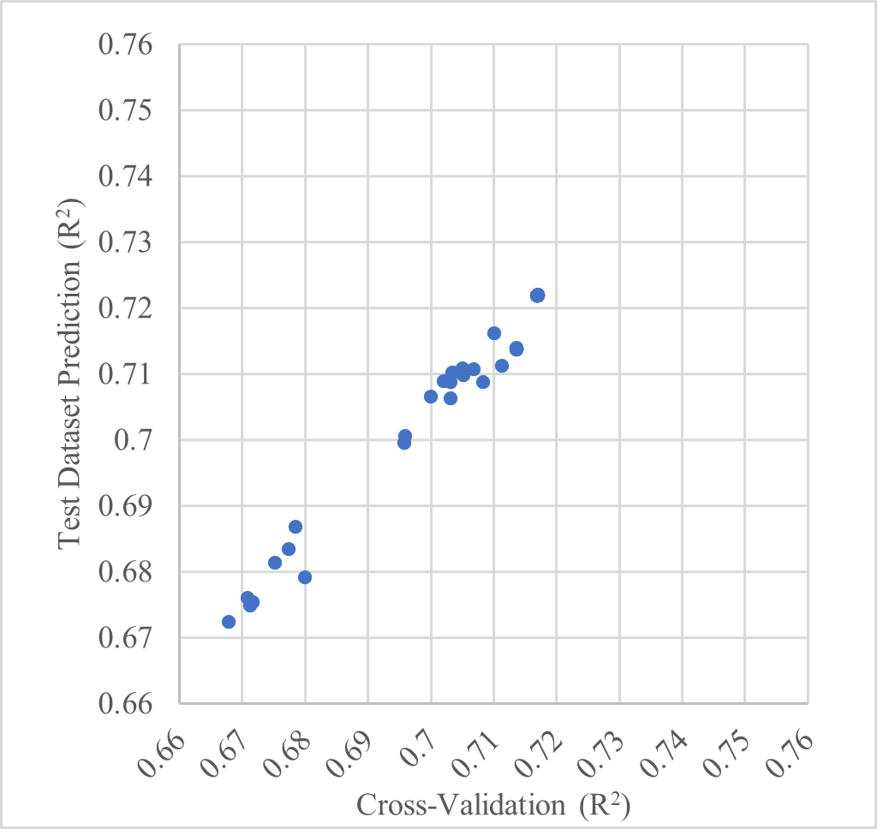
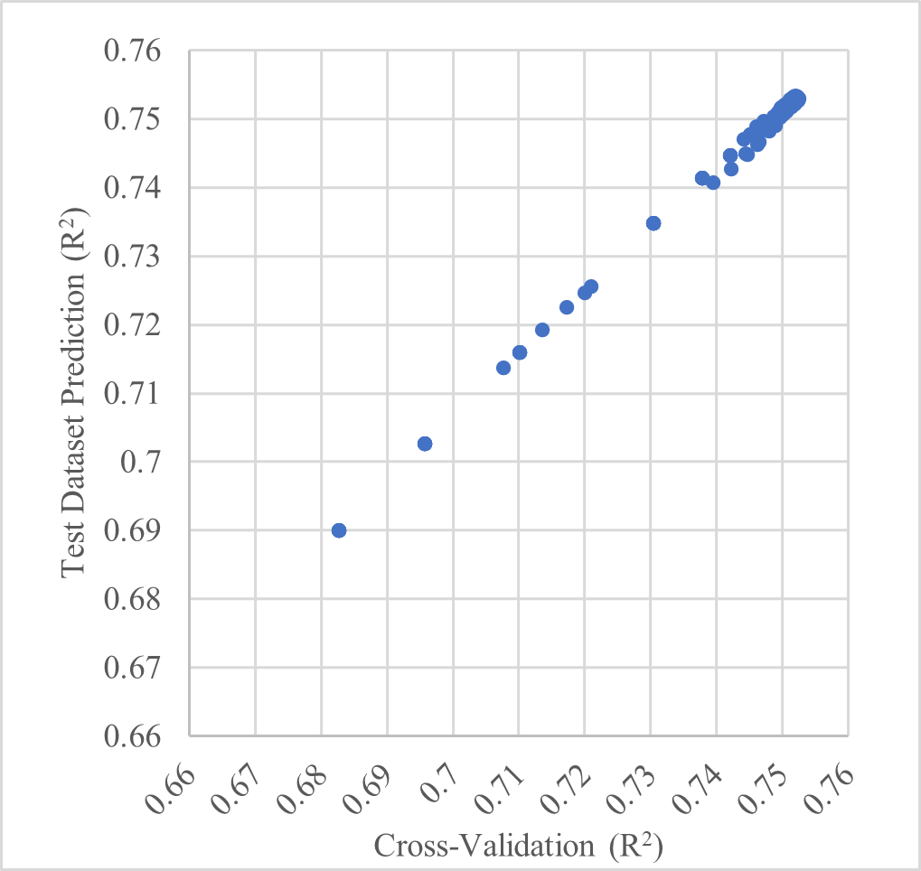
Results
During RFECV iterations
R-squared
0.7526 - cross validation
0.7528 - test dataset prediction
Similar trends between cross-validation and test dataset prediction
Suggests model generalizes well for unseen data
During hyperparameter tuning (after RFECV)

Slide 15
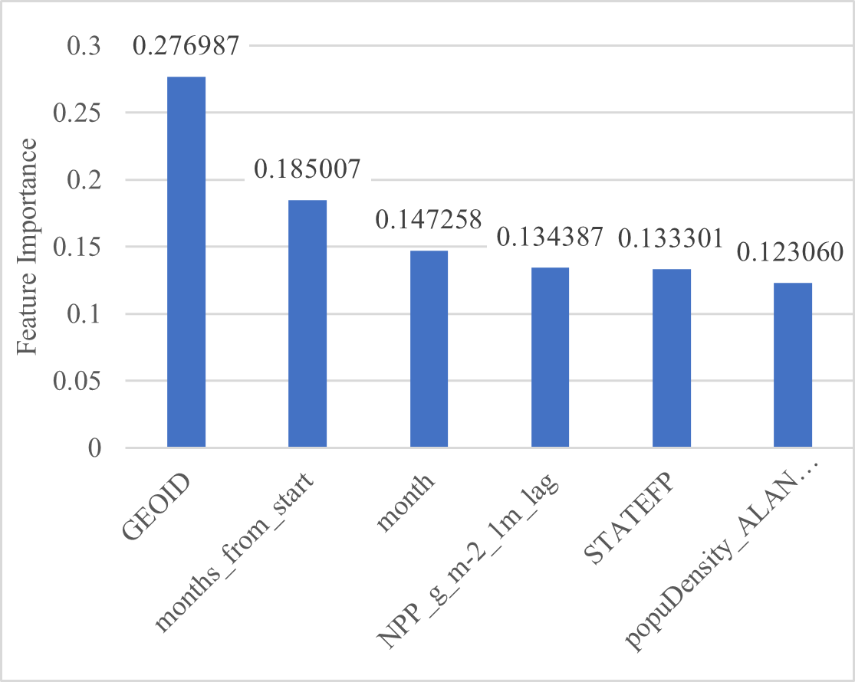
Results - Selected Features
GEOID - county encoder
Months from start of period (since January, 2000)
Month of the year
Net primary production (NPP), lagged by 1 month
STATEFP - state encoder
Population density, adjusted by land area

Slide 16
Data Limitations
Using mortality as target variable
Mortality only captures most extreme cases of disease exacerbation
Limited data of Emergency Room Visits (ERVs) by county
ERVs by country - commonly used to measure disease exacerbation
Estimates of the Global Burden of Ambient PM2.5, Ozone, and NO2 on Asthma Incidence and Emergency Room Visits
Mortality data - suppression constraints
Data points with less than 10 deaths are unavailable
Estimated based on state total
Monthly, county-level datasets not available for:
Humidity
Used precipitation, drought indices instead
Ground-level ozone
estimated asthma ERVs in 2015:
Ozone: 9–23 million
PM2.5: 5–10 million

Slide 17
Other Limitations
Coarse resolution - monthly, county-level datasets cannot represent phenomena present in finer spatiotemporal resolutions (i.e. cities, days)
Air pollution and emergency department visits for respiratory diseases: A multi-city case crossover study
ERVs for respiratory diseases increase after days with higher concentrations of pollutants
Lagging effect on ERVs lasts only several days
Excluded factors
tobacco smoking (human behavior)
airborne allergens
Many “non-infectious” lung diseases are influenced by infectious microorganisms
active area of investigation

Slide 18
Comparison - Cholera Outbreaks in India
Cholera Risk: A Machine Learning Approach Applied to Essential Climate Variables
Random forest classification (scikit-learn)
Essential Climate Variables (ECVs)
Chlorophyll-a, Land/Sea Surface Temperature, Soil Moisture, Total Precipitation, etc
Vibrio cholerae
Infectious; prevalent in coastal areas
Strong spatiotemporal relationships between ECVs and distribution of V. cholerae bacteria
Allows accurate predictions of cholera outbreaks
Sensitivity = 0.895; correctly identified 89.5% of outbreaks
ROC = 0.984

Slide 19
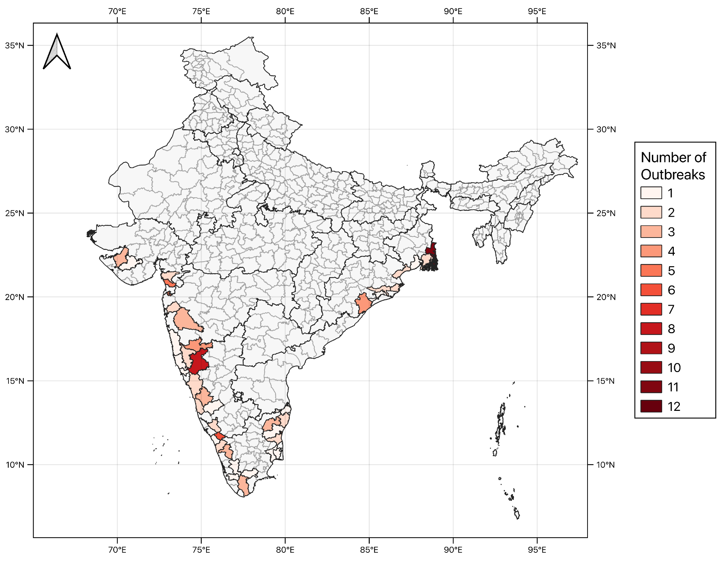
Number of cholera outbreaks reported; 40 coastal districts; 2010 - 2018

Slide 20
Main conclusions
Significant potential for modeling CRD risk (R-squared ≈ 0.75)
Limitations
data limitations
phenomena only found on finer spatiotemporal scales (i.e. cities, days)
primarily non-infectious nature of CRDs
Caveats of ML
can naively test for features that improve model performance
mechanisms behind their relationships remain unclear
Accessible data of climate variables may improve estimates of ERVs attributable to specific pollutants
Estimates of the Global Burden of Ambient PM2.5, Ozone, and NO2 on Asthma Incidence and Emergency Room Visits

Slide 21
Next Steps
Use better methods for hyperparameter tuning
Gradient-based rather than grid search
Address asymmetry of importance
imbalanced regression
Use different ML techniques
neural networks
Use datasets from alternative sources
Datasets may be developed differently
New datasets may appear in the future

